Slide 1


Text-based Emotion Classifier
Presented by Group 4
Lee Juin
Lee Ci Hui
Kassim Malaysia

Slide 2


Preface
01
Problem formulation & dataset selection

Slide 3
Motivation
Texting is the preferred way of communication
Average of 67 texts sent per day
(Lenhart, 2015)

Slide 4
Problem Formulation
Text messages omit tone and emotion - causing potential misinterpretation in the meaning of the text messages.

Slide 5
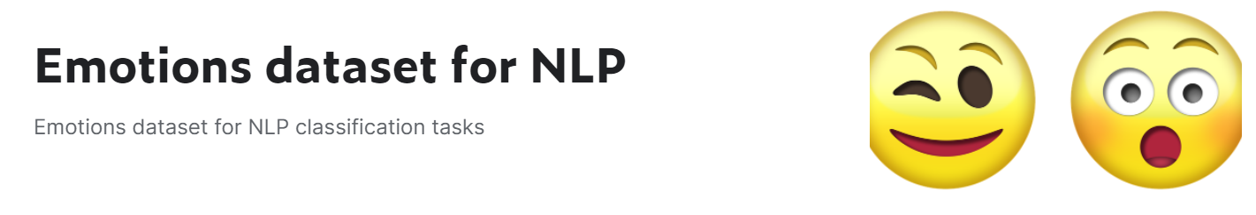
Dataset
Source: https://www.kaggle.com/praveengovi/emotions-dataset-for-nlp by Praveen

Slide 6

Data
Preparation
02
Preliminary insights & data cleaning

Slide 7
Data Description of Train Dataset
 | text | emotion
count | 16000 | 16000
unique | 15969 | 6
top | i feel on the verge of tears from weariness i ... | joy
freq | 2 | 5362

Slide 8

Preliminary
Data Exploration

Slide 9

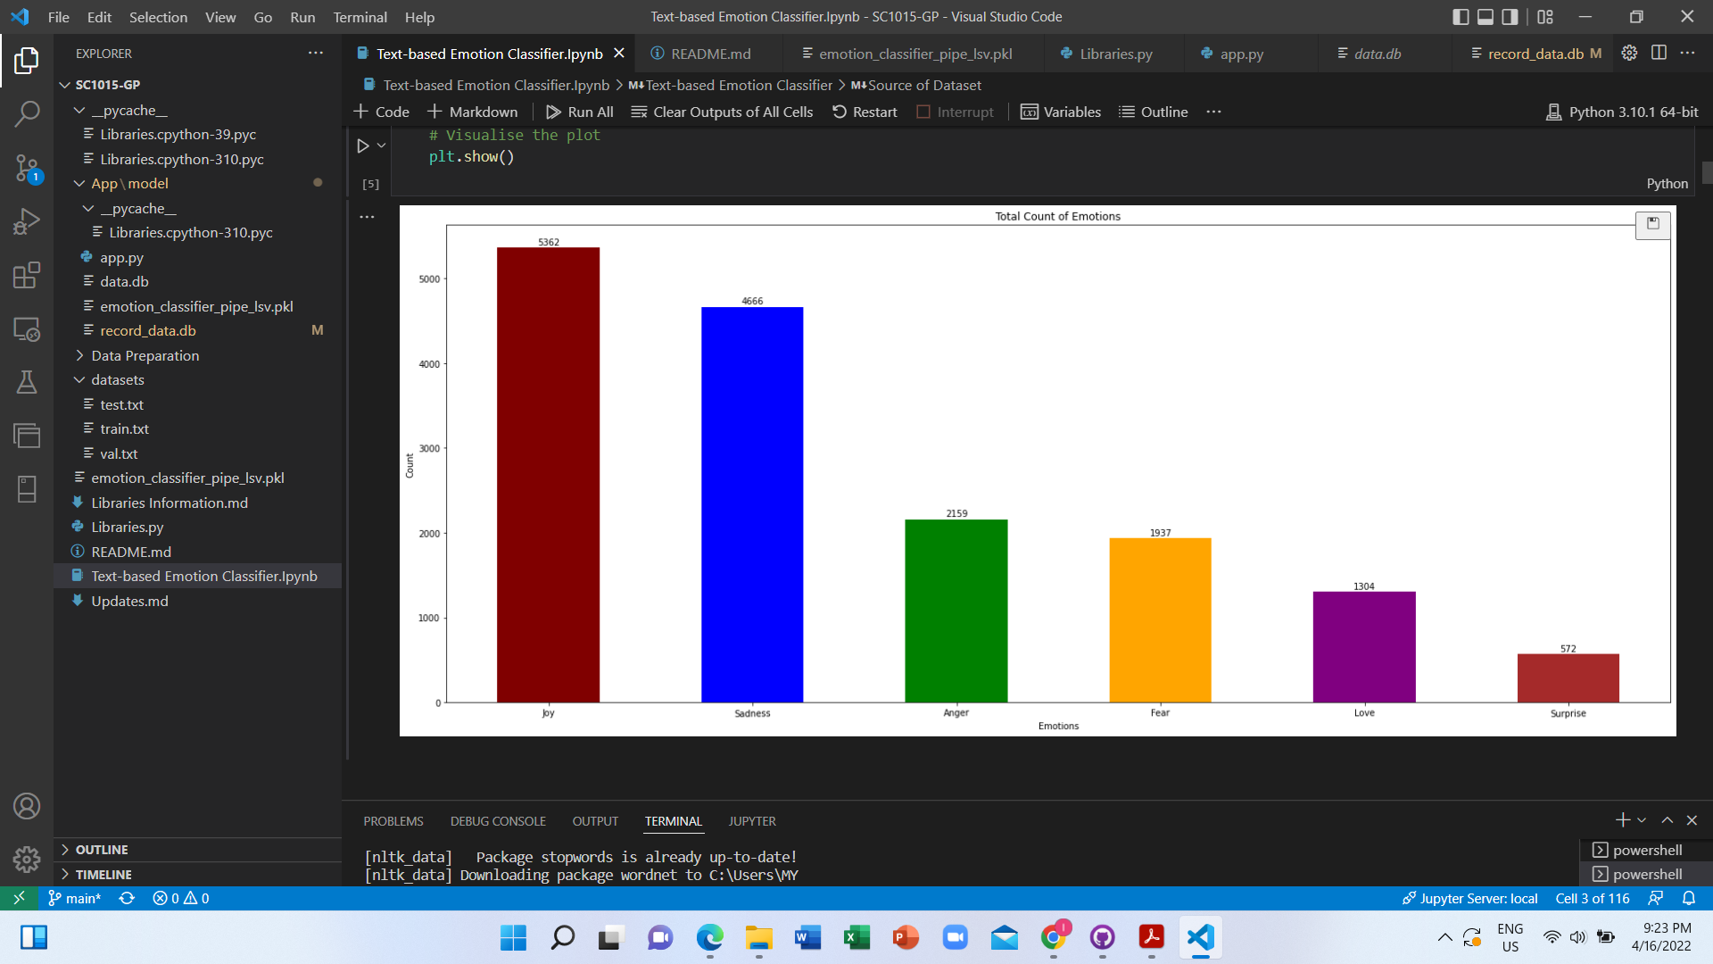
Visualise Data (Count Plot of Emotions)

Slide 10
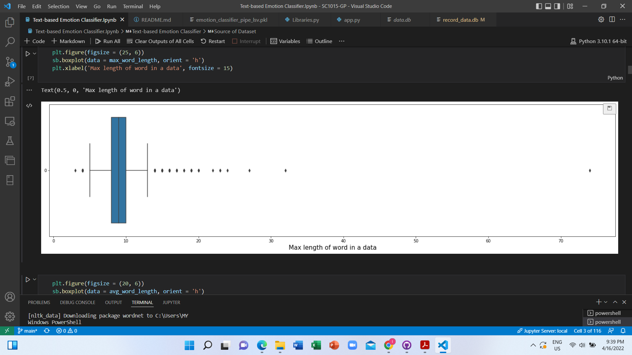
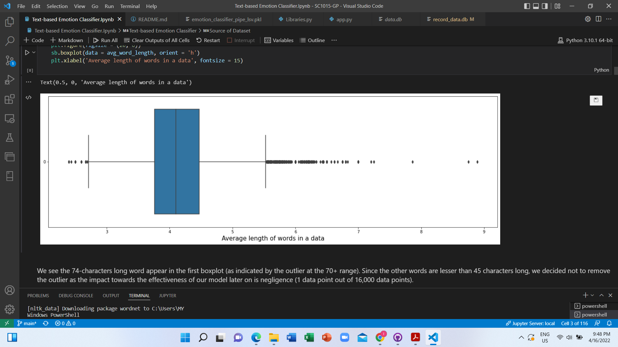
Spam
Suspicious texts?
=> Words that are extraordinary long
Typo
MAX LENGTH OF WORD
The longest word in data:
Character count of 74
The longest legitimate word in English:
Character count of 45
AVERAGE LENGTH OF WORD

Slide 11
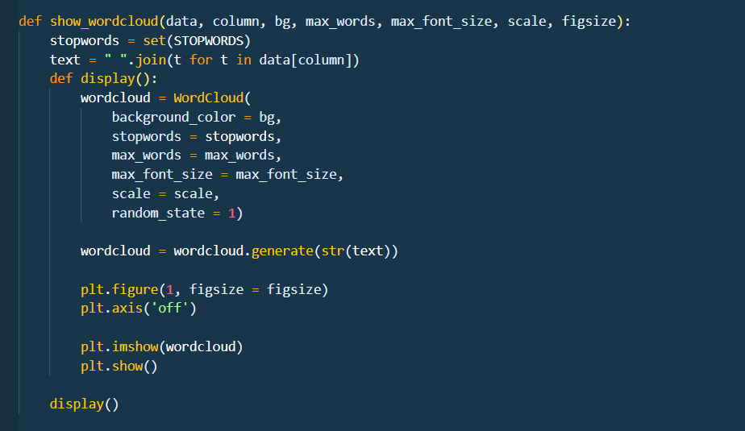
WORDCLOUD
as primary mean for dataset analysis

Slide 12
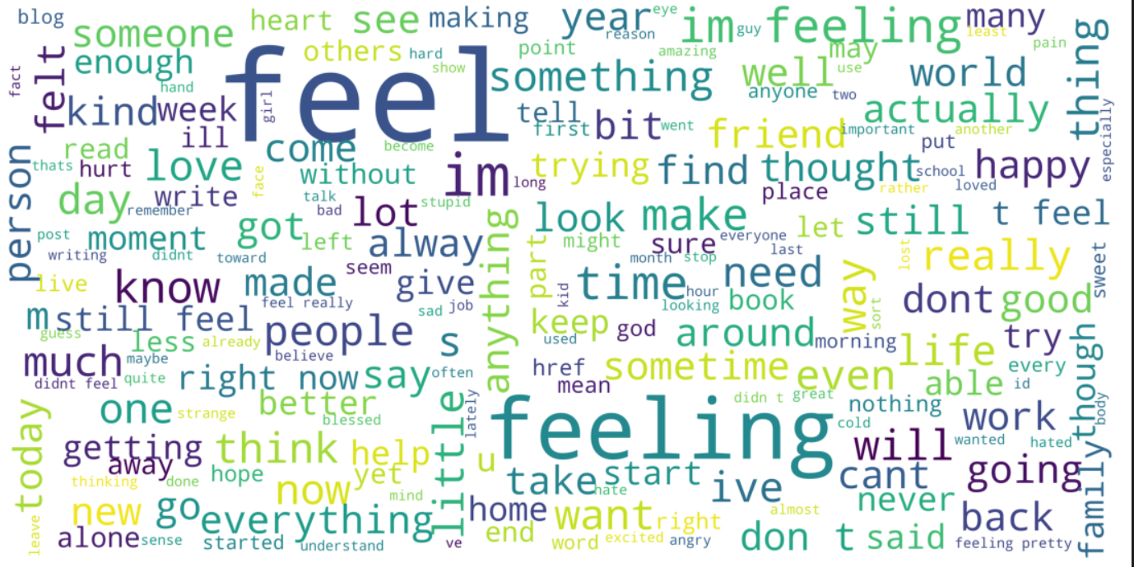
Raw Train Dataset

Slide 13
Duplicated Data Investigation

Slide 14
Duplicated Data
31 duplicated sentences conveying 2 different emotions
index | text | emotion 1 | emotion 2
0 | i feel on the verge of tears from weariness i ... | love | joy
1 | i still feel a craving for sweet food | joy | love
2 | i tend to stop breathing when i m feeling stre... | sadness | anger
3 | i was intensely conscious of how much cash i h... | anger | sadness
4 | im still not sure why reilly feels the need to... | fear | surprise
5 | i am not amazing or great at photography but i... | joy | love
6 | ive also made it with both sugar measurements ... | love | joy
7 | i had to choose the sleek and smoother feel of... | love | joy
8 | i often find myself feeling assaulted by a mul... | fear | sadness
9 | i feel im being generous with that statement | love | joy
10 | i feel pretty tortured because i work a job an... | anger | fear

Slide 15
'There is this irky feeling in me that I cannot describe..'
FEAR
SURPRISE
Same sentences, convey different meanings
Expressions become ambiguous when they contain words/sentences with duality/multiple meanings
We opt to
Keep duplicated data with different emotions

Slide 16
Duplicated Data
31 duplicated sentences conveying 2 different emotions
index | text | emotion 1 | emotion 2
20 | i feel more adventurous willing to take risks ... | joy | joy
Decision
Remove the duplicated entry which share the same emotion

Slide 17
Cleaning
Train Dataset

Slide 18
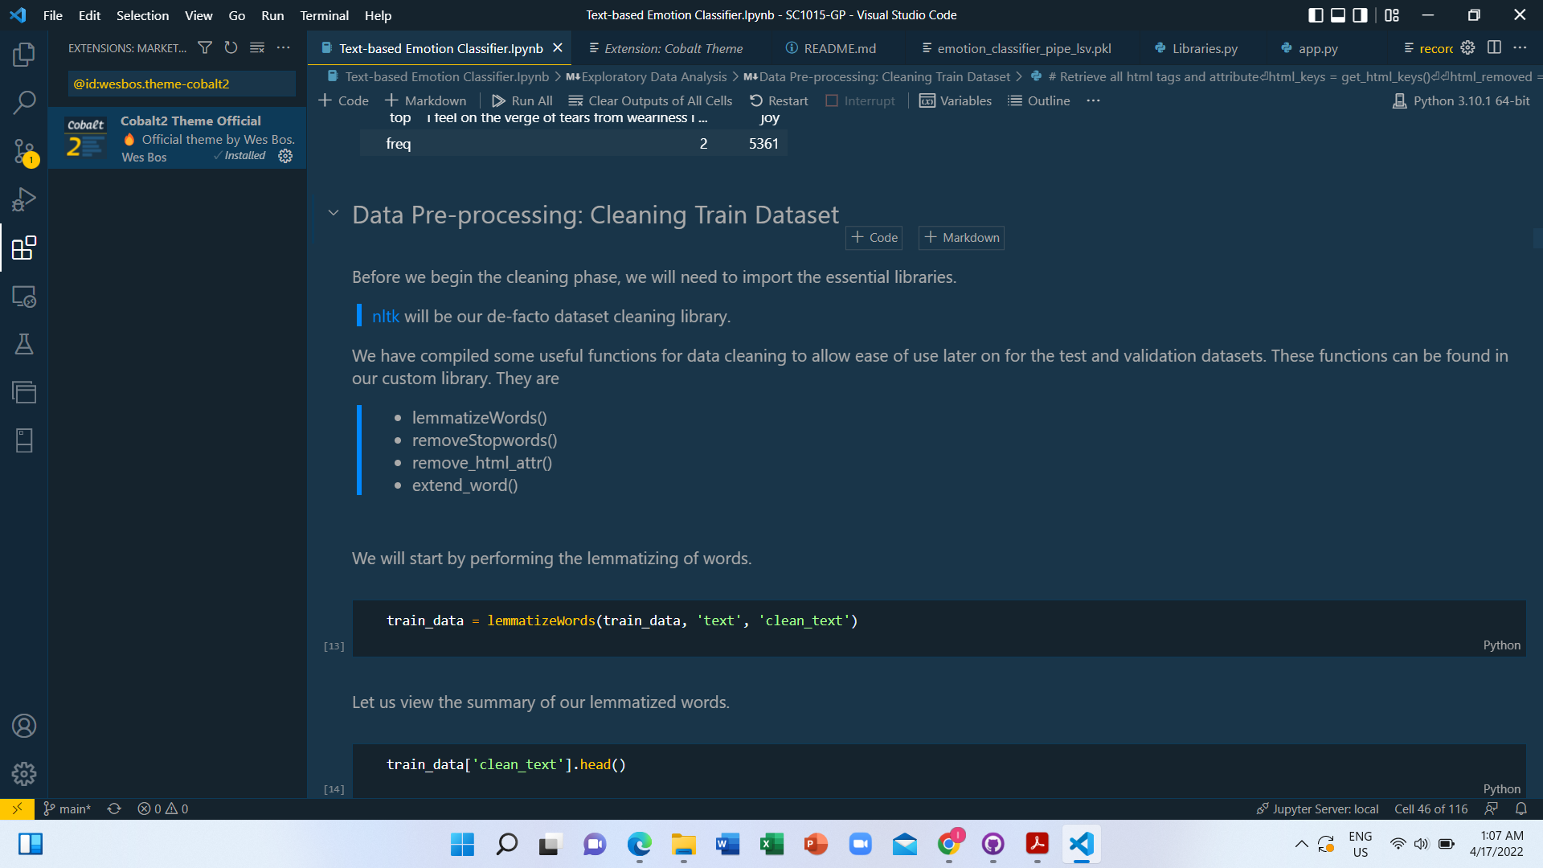
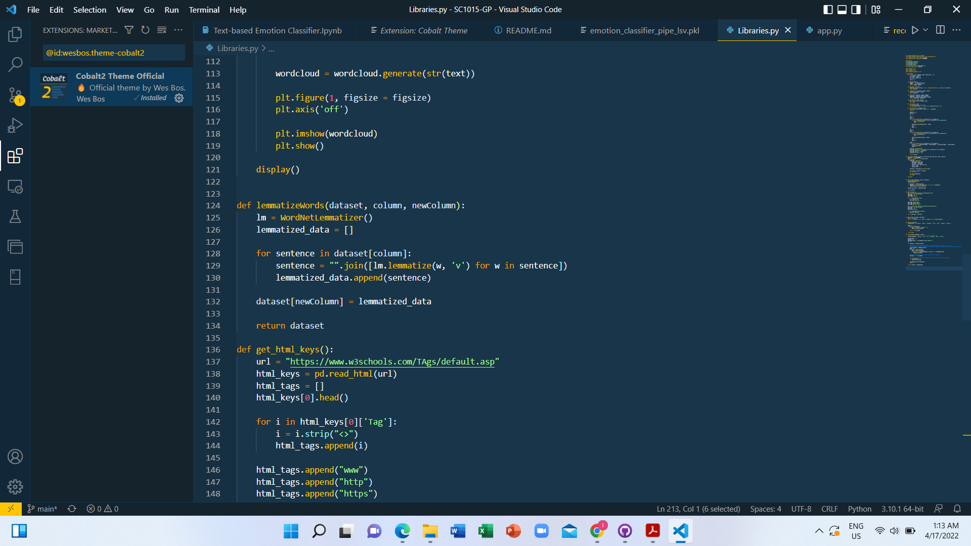
NLTK
De-facto dataset cleaning library

Slide 19
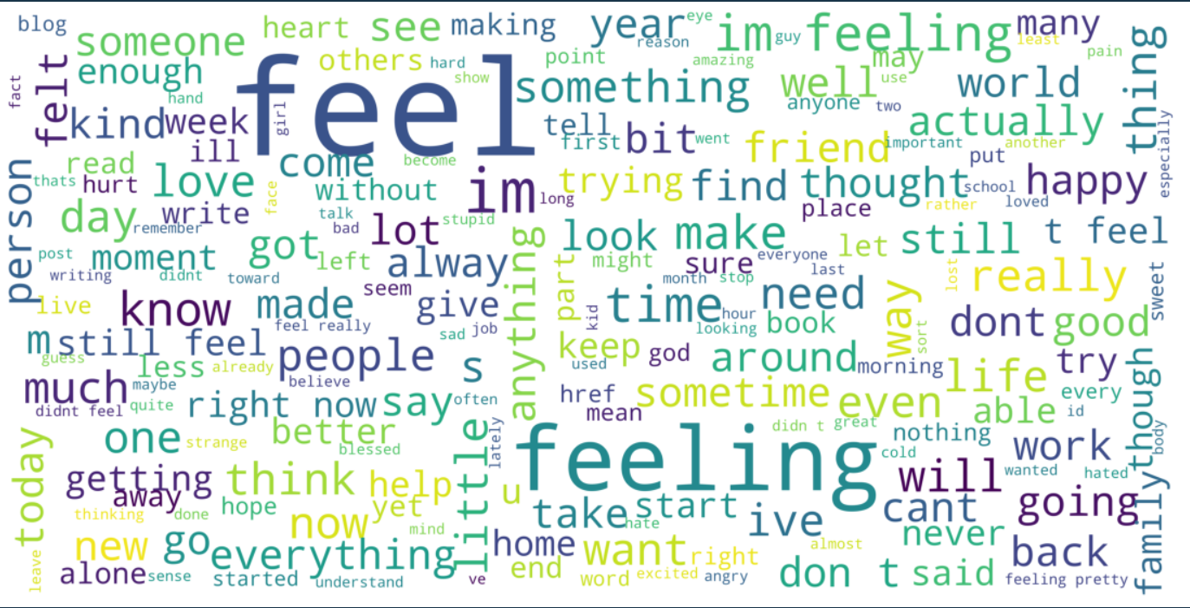
PHASE 1 (Word Lemmatization)
After Lemmatization:
Can be adjective instead of verb with continuous tense
NLTK’s WordLemmatizer classifies words into their respective part-of-speech

Slide 20
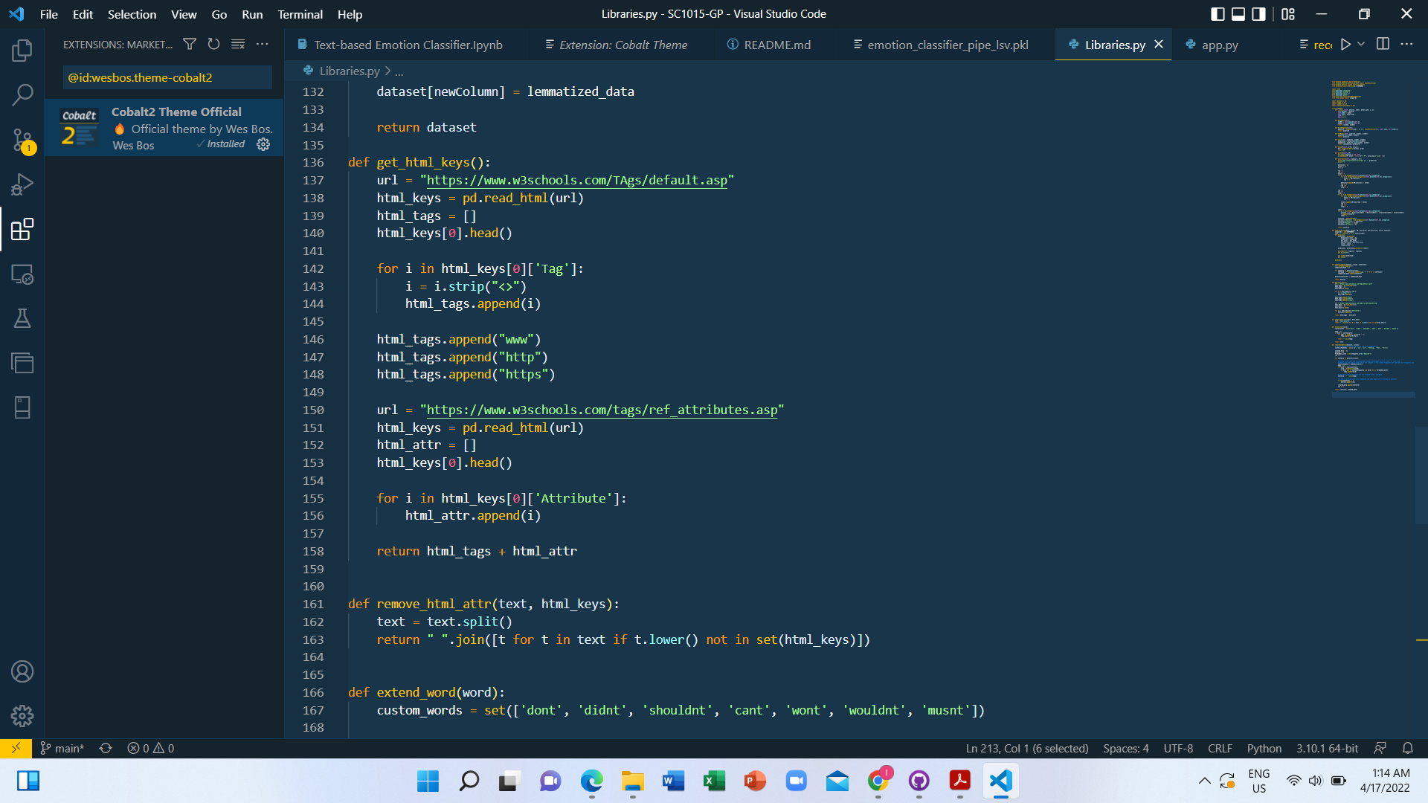
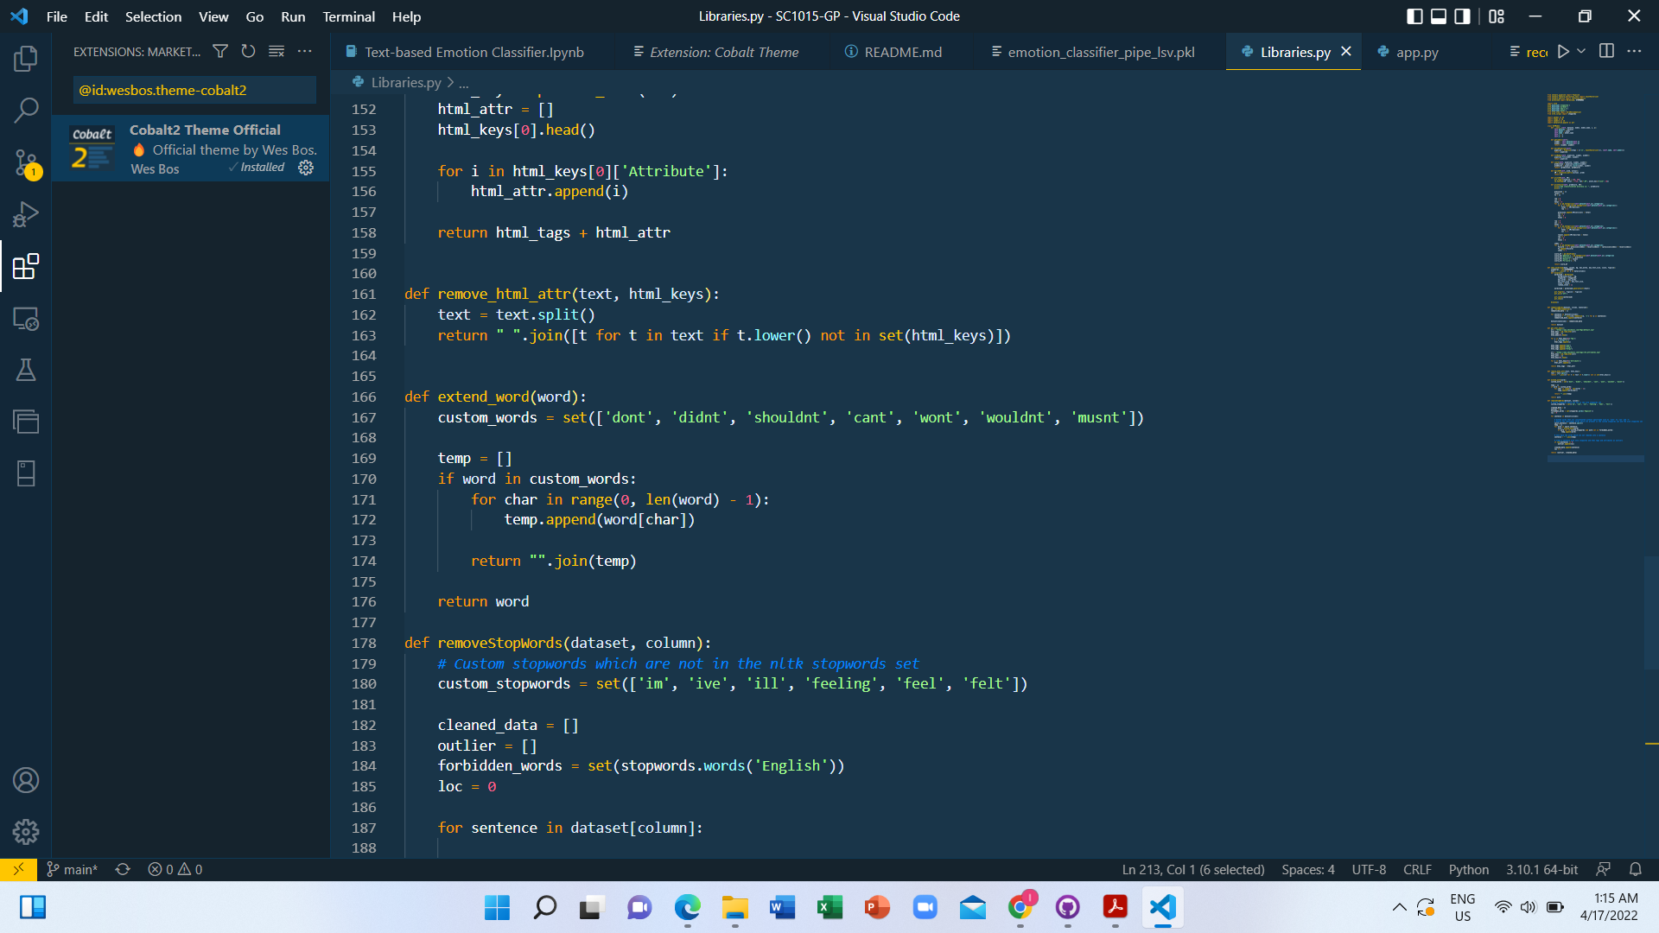
NLTK
De-facto dataset cleaning library

Slide 21
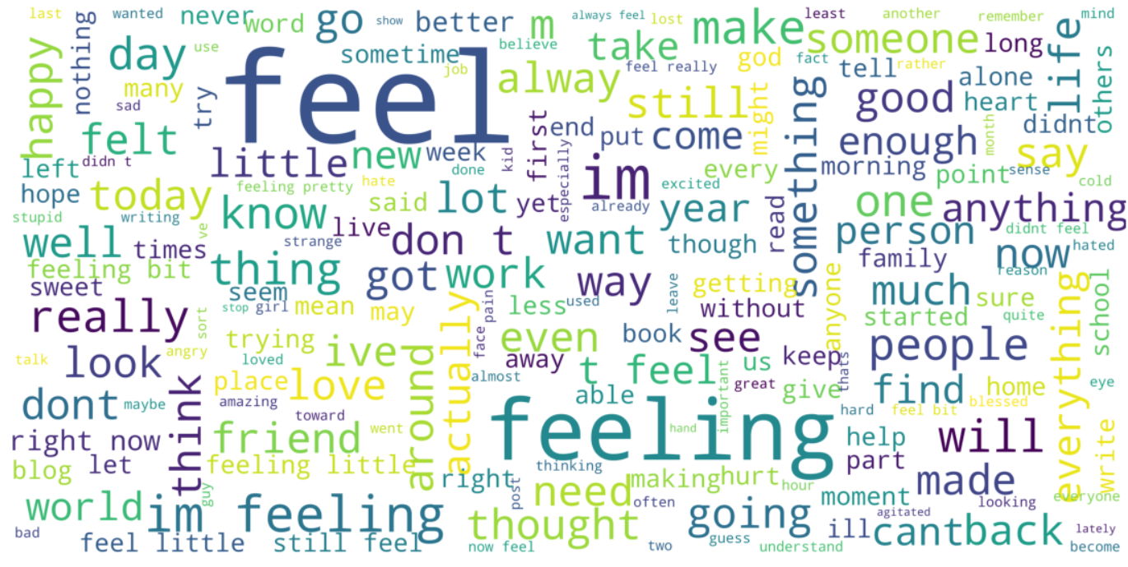
PHASE 2 (Removal of html tags and attributes)
Before Removal:
After Removal:

Slide 22
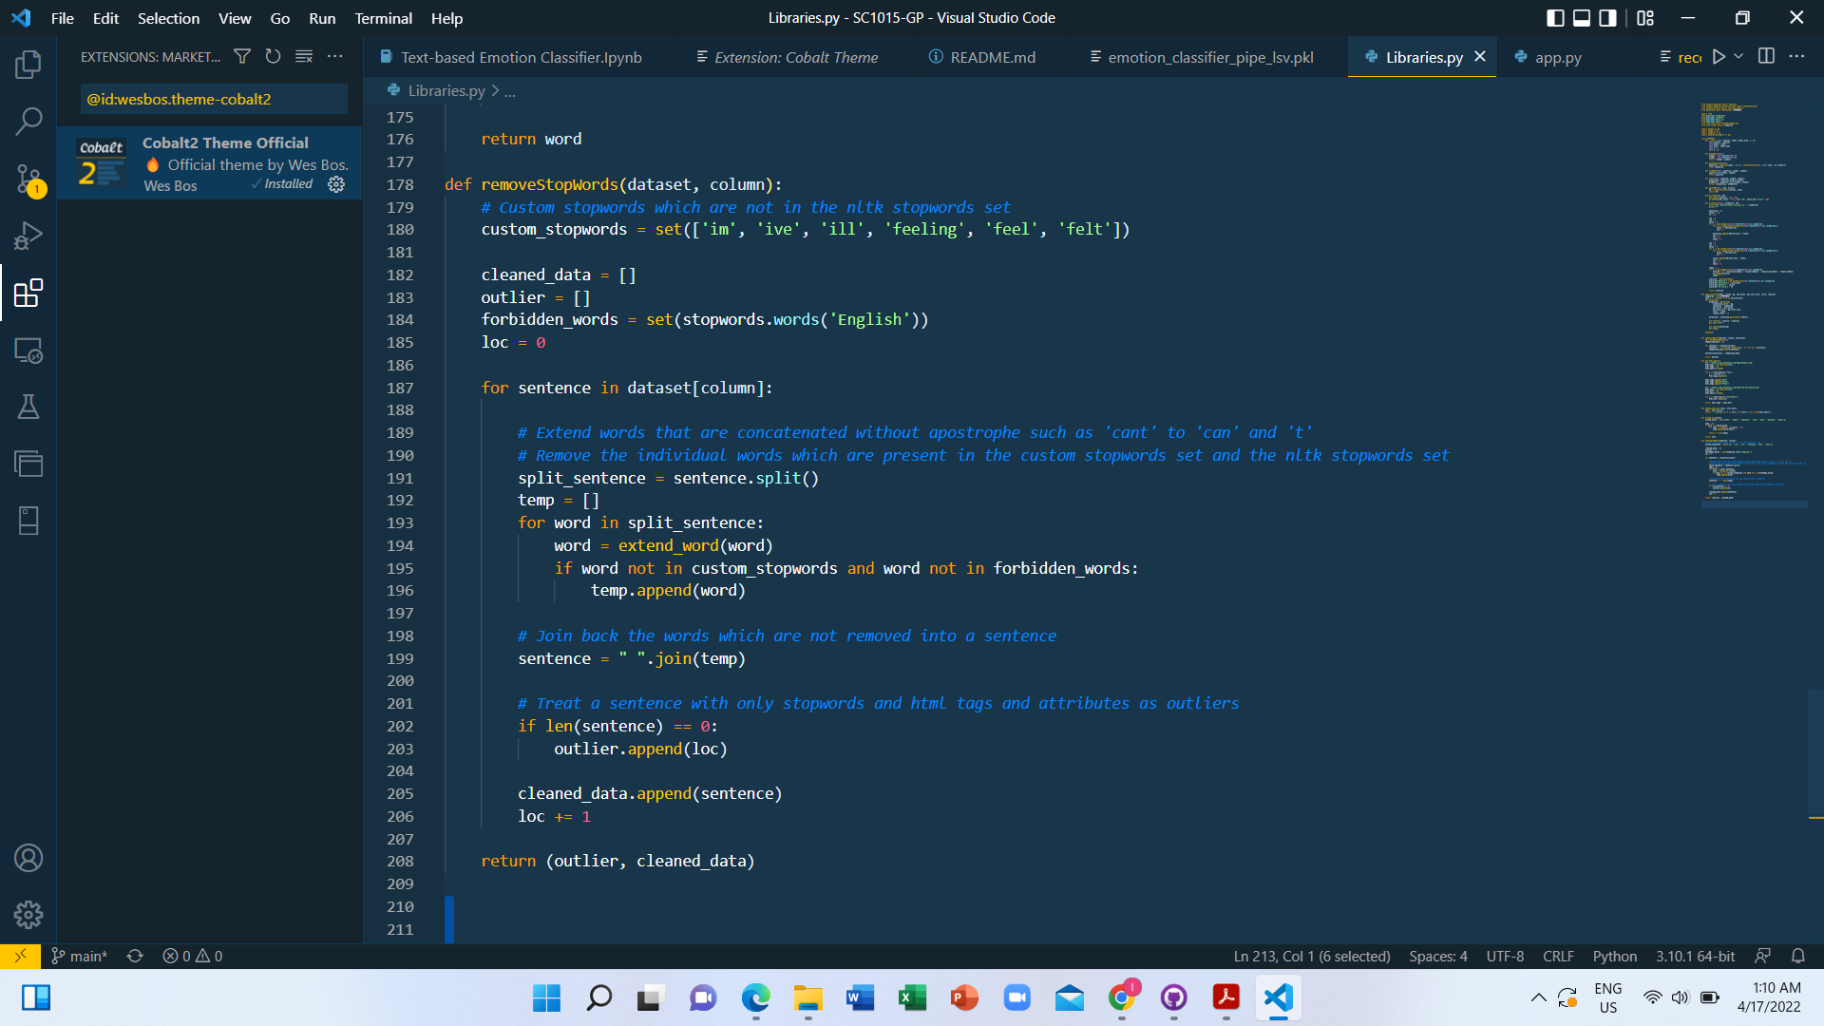
NLTK
De-facto dataset cleaning library

Slide 23
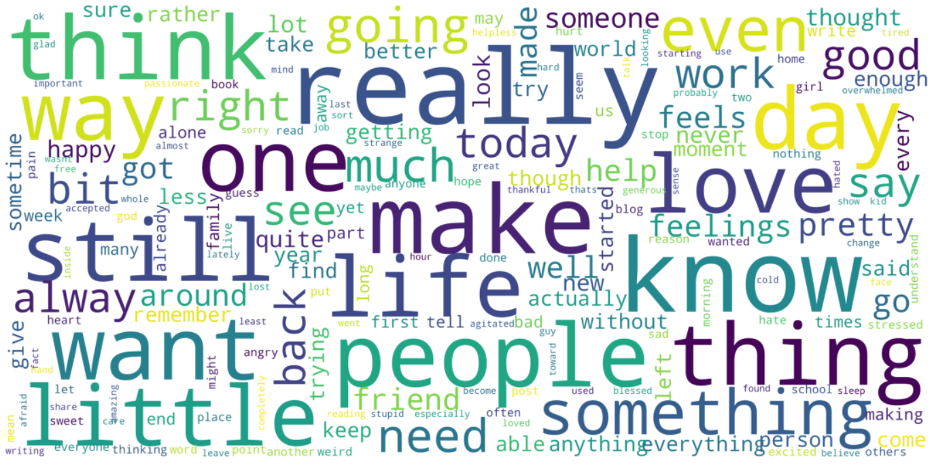
PHASE 3 (Removal of Stopwords)
Before Removal:
After Removal:
Missing apostrophe
=> Extend the word out before removal

Slide 24

Exploratory Data Analysis
03
Exploration and analysis stage

Slide 25
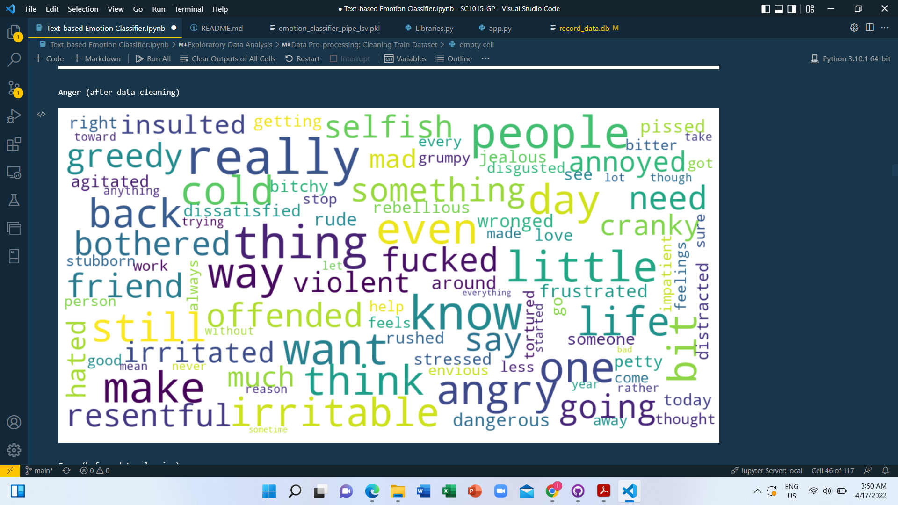
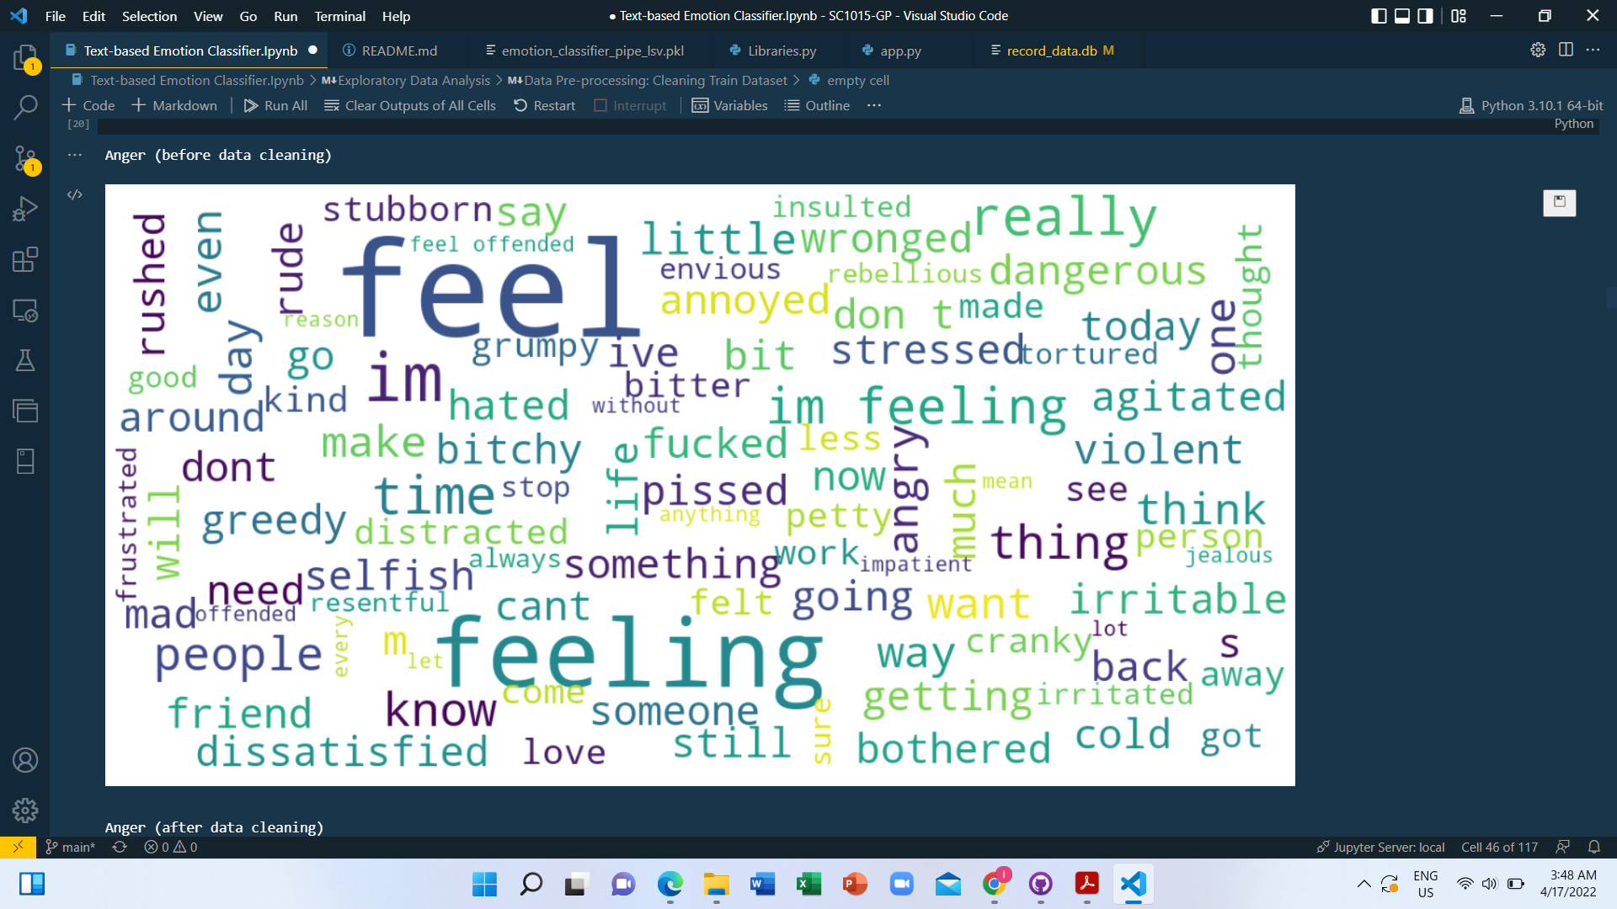
Anger

Slide 26
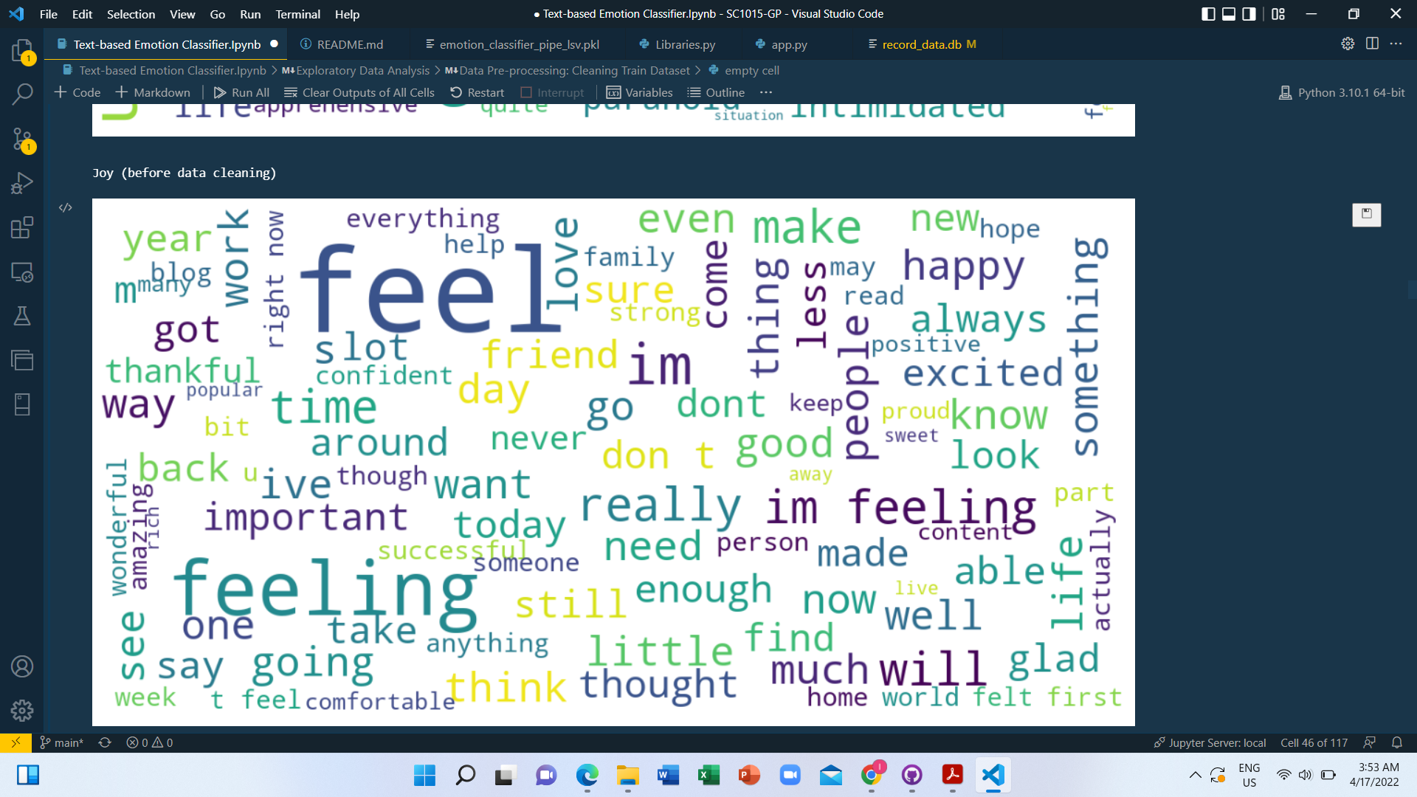
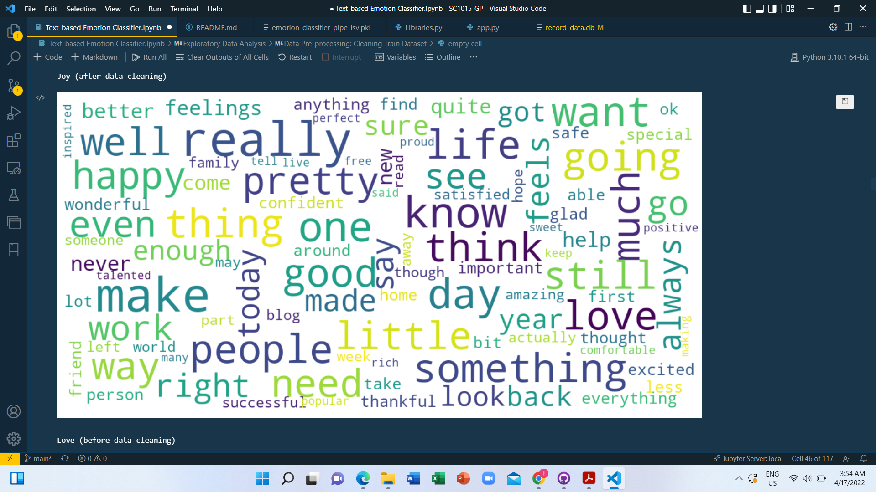
Joy

Slide 27
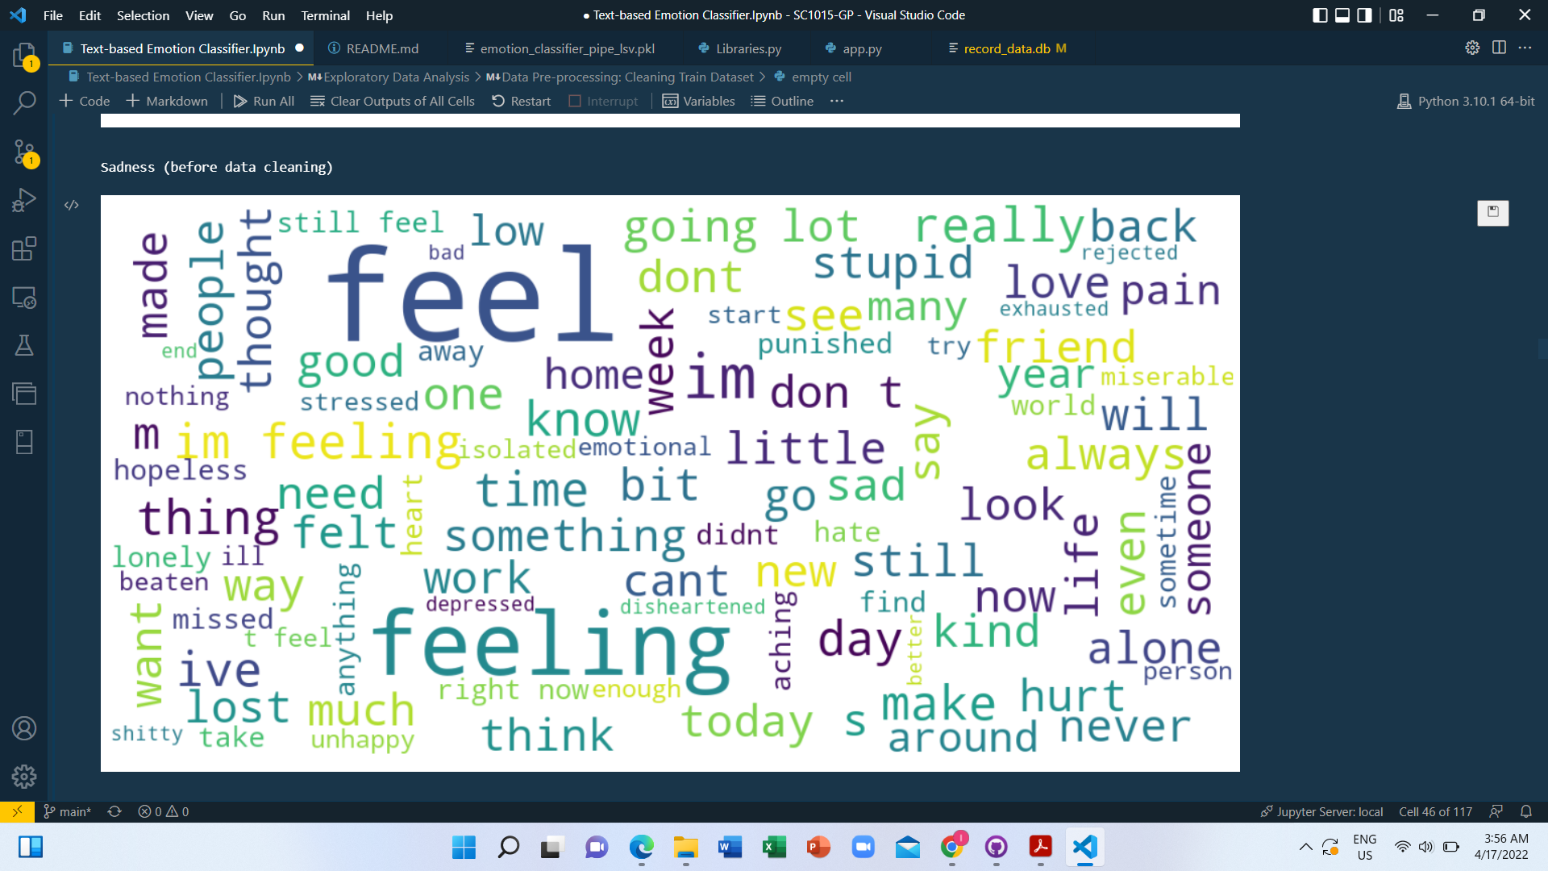
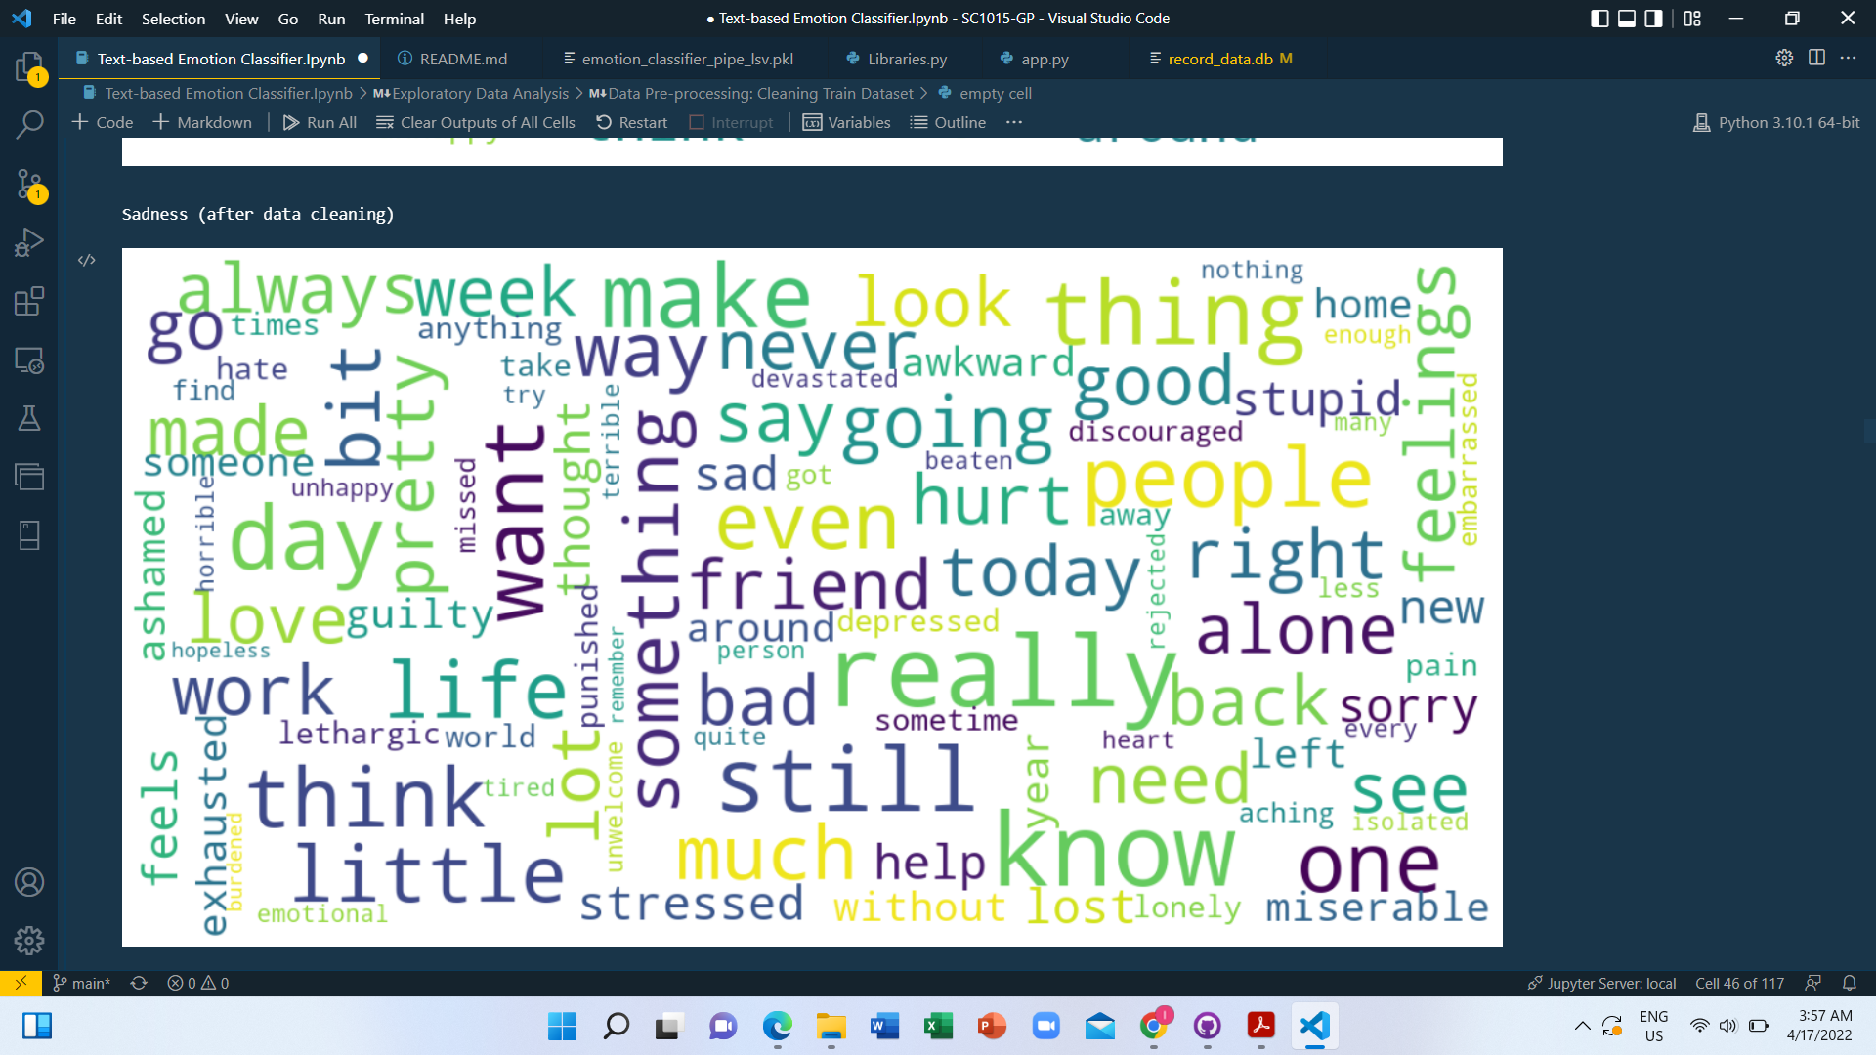
Sadness

Slide 28
Further Data Exploration

Slide 29
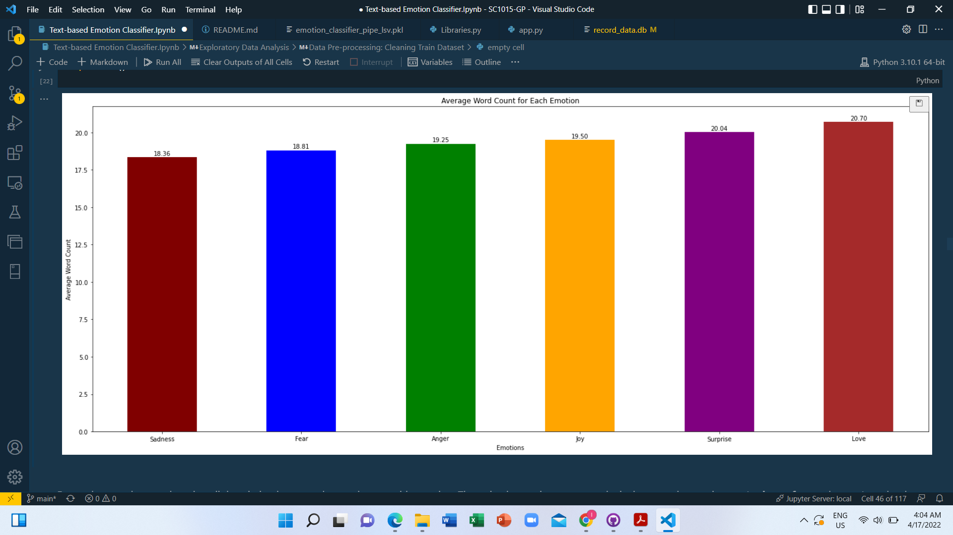
Number of words in a sentence vs emotion
Negative sentiments
<
Positive sentiments
Before cleaning
(Sadness, Fear, Anger)
(Joy, Surprised, Love)

Slide 30
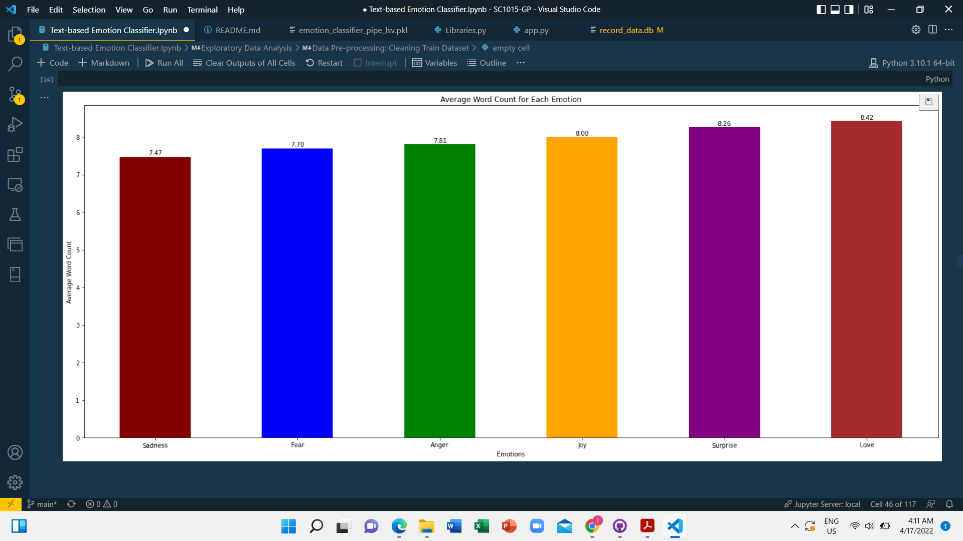
Number of words in a sentence vs emotion
Same Trend
Inferences:
After cleaning
The number of stopwords and html tags in each data points are roughly equivalent.
Data cleaning seems to be effective without “overcleaning”

Slide 31

Machine Learning
04
Training and modelling stage

Slide 32
TEXT-BASED EMOTION CLASSIFIER
LOGISTIC REGRESSION
NAIVE BAYES ALGORITHM
LINEAR SUPPORT VECTOR MACHINE

Slide 33
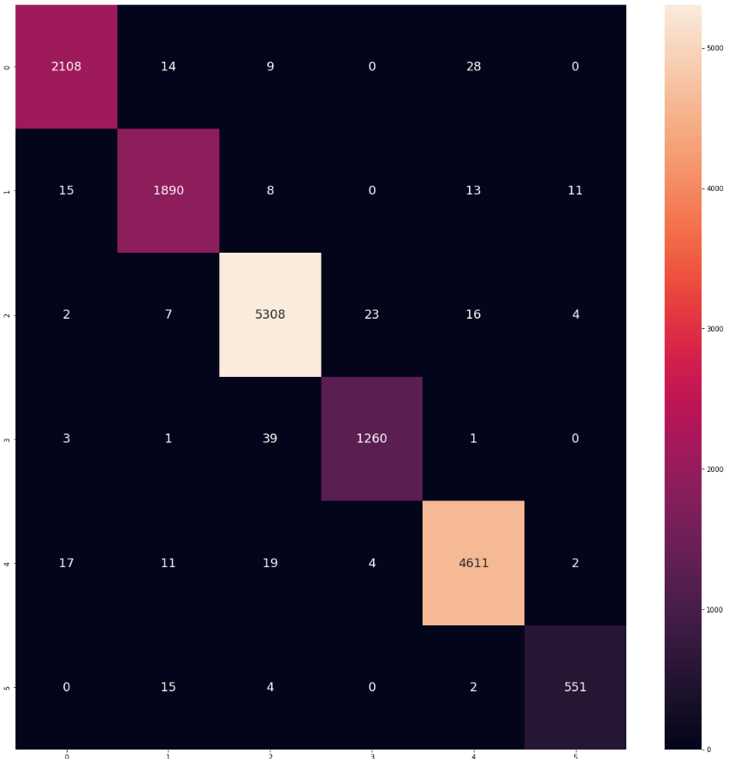
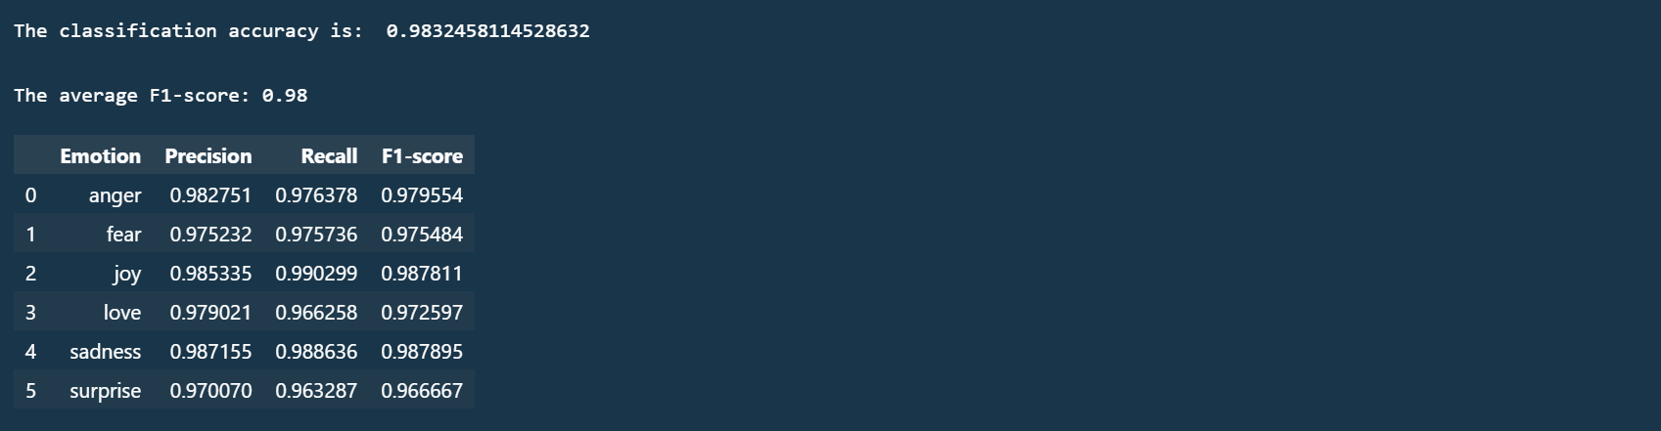
LOGISTIC REGRESSION
TRAIN

Slide 34
F1-score for each emotions in the respective models
Emotions | Logistic Regression |  | Naive Bayes |  | Linear Vector Support Machine
 | Train | Validation | Train | Validation | Train | Validation
Anger | 0.980 | 0.902 | 0.928 | 0.789 | 0.991 | 0.915
Fear | 0.975 | 0.843 | 0.903 | 0.759 | 0.989 | 0.845
Joy | 0.988 | 0.919 | 0.934 | 0.861 | 0.996 | 0.924
Love | 0.973 | 0.835 | 0.813 | 0.559 | 0.983 | 0.839
Sadness | 0.988 | 0.927 | 0.939 | 0.823 | 0.995 | 0.924
Surprise | 0.967 | 0.785 | 0.636 | 0.365 | 0.983 | 0.810

Slide 35
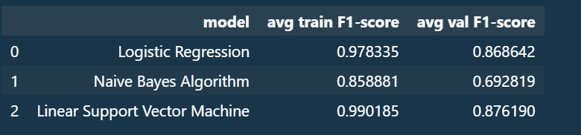
Model Evaluation

Slide 36
Cross-
Validation

Slide 37
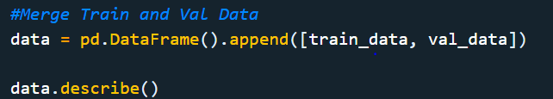
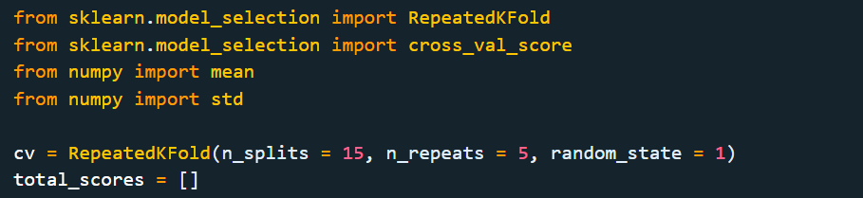
Pre-Validation Preparation

Slide 38
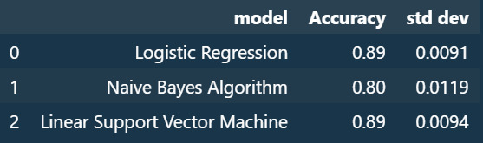
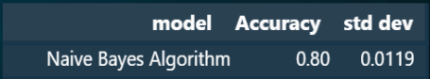
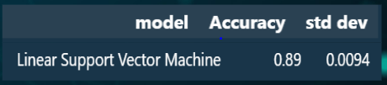
LOGISTIC REGRESSION
NAIVE BAYES ALGORITHM
LINEAR SUPPORT VECTOR MACHINE

Slide 39
Most Suitable Model

Slide 40
LOGISTIC REGRESSION
LINEAR SUPPORT VECTOR MACHINE
Binary Prediction
Multi-Class Prediction
For example: Most likely to get diabetes
For example: Image Classification
Works with unstructured data and semi-structured data
Works with Independent variables
Notes:
Binary Prediction

Slide 41
Model Testing

Slide 42
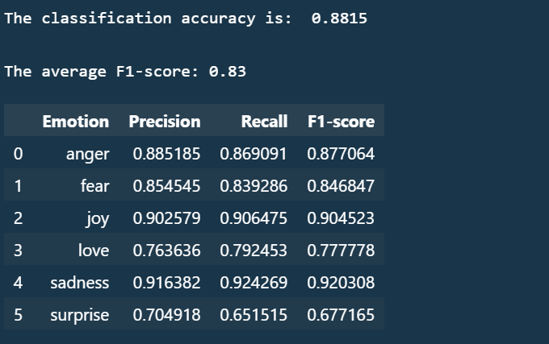
Results
LINEAR SUPPORT VECTOR MACHINE

Slide 43

Application
Text-to-Emotion Classifier App
05
Product Presentation

Slide 44
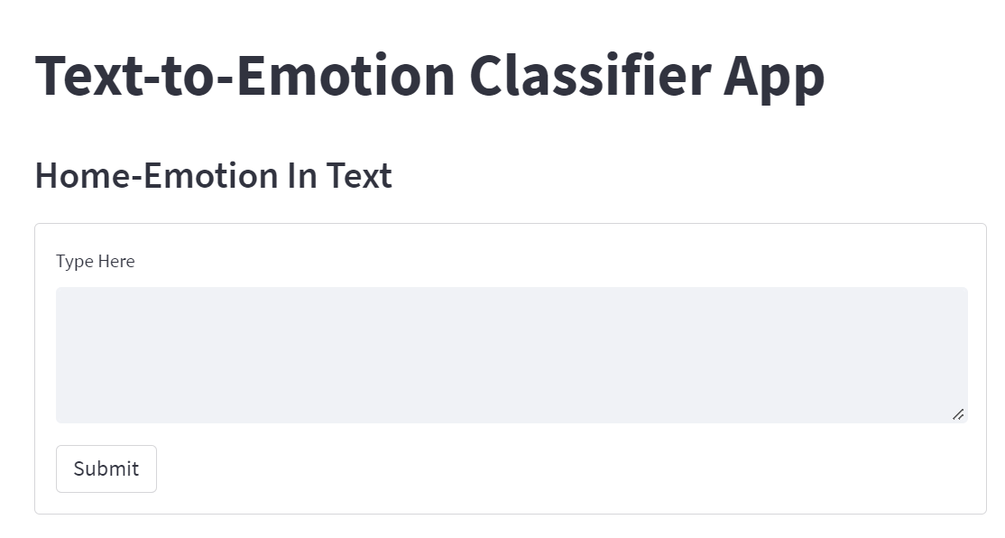

Slide 45
Final Thoughts
06
What we learnt & what’s next?

Slide 46
Learning Outcomes
Perform Exploratory Data Analysis on unstructured data (texts) using Word Cloud.
Concepts about Recall, Precision & F1-score.
Logistic Regression, Linear Support Vector Machine & Naive Bayes Algorithm implementation
in Machine Learning.
Implementation of Cross-Validation Check.
Implementation of an application's graphical user interface using Streamlit.
Elementary Object-Oriented Programming during the standardization of functions & classes.
Introduction to documentation writing.
Collaboration using GitHub.

Slide 47
What’s Next?
Sentimental analysis of customer review
Sentimental analysis of movie ratings
Online dating profile matching algorithm fine-tuning

Slide 48


Thank You!!!
Lee Juin (U2120621A):
Codes
Lee Ci Hui (U2123083J):
Application
Kassim Malaysia (U2122696C):
Scripts & Slides

Slide 49
References
Lenhart A. (2015). Teens, social media & technology overview 2015. Retrieved April 28, 2015, from http://www.pewinternet.org/2015/04/09/teens-social-mediatechnology-2015/

